Slide 1
Command {abstract}
Generate calendar
TaskList
+ execute() {abstract}
+ showUserMessage(String messages)
CalendarCommand
- daysInMonth: Integer
- totalDays: Integer
- totalWeeks: Integer
- startingDay: Integer
- month: Integer
Calendar
- checkMonth: Integer
- getStartingDay(): Integer
- getTotalWeeks(): Integer
- getTotalDays(): Integer
+ getMonthDetails(): Integer[]
+ setMonth(n: Integer)
+ execute( ):
- setNumber(n: Integer)
+ CaldendarCommand(month: Integer)
Check details
Search tasks
1
TaskList
Task
+ searchDate(n: Date): ArrayList<task>
- date: Date
*
+ getDate(): Date

Slide 2
CalendarCommand
:Calendar
tasks: TaskList
Ui:UI
execute()
getMonthDetails()
loop [weeks in month]
loop [days in week]
searchDate()
List of tasks
showUserMessage()
CommandResult

Slide 3
Common
Exceptions
UI
Calendar
Command
Main
Task
Parser
Storage
Local storage
*Arrow heads represent navigability of components
** Dashed body arrows represents being accessible by all components
Notes:
Main
UI
Storage
Parser
Command
Common
Tasklist
Task
Calendar
Exception

Slide 4
ExitCommand
Display result of command
CommandResult
User issued command
Main
{abstract}
Command
1
Send feedback for printing
Ui
showResultToUser(CommandResult)
Notes:
Main
UI
Storage
Parser
Command
Common
Tasklist
Task
Calendar
Exception

Slide 5
TaskList
1
Contains Task
*
{Abstract}
Task
~ title: String
~ description: String
~ reminder: String
~ category: String
~ time: ArrayList<LocalTime>
~ date: ArrayList<LocalDate>
~ location: ArrayList<String>
Class
TaskNonClass
Notes:
Main
UI
Storage
Parser
Command
Common
Tasklist
Task
Calendar
Exception

Slide 6
Command{abstract}
uses
UI
+execute(){abstract}
+showCategory(arr[string])
+showTask(arr[int])
+ execute()
- getWholeList (listTaskIndex : ArrayList<Integer>)
-getListByDateCategory (listTaskIndex : ArrayList<Integer>, date : String, time : String, category : String)
- getListByDate(listTaskIndex : ArrayList<Integer>, date : String, time : String)
- getListByCategory (listTaskIndex : ArrayList<Integer>, category: String)
ListCommand
AddCommmand
+execute()
1
1
{Abstract}
Task
TaskList
TaskList
-categoryMap: Map(string, arr[int])
-tasks: ArrayList(Task)
1
*
~ category: String
+ getCategory():string
+ getTime():ArrayList<LocalTime>
+ getDate():ArrayList<LocalDate>
+ getTask():string
+getCategoryTask(category:String):arr[int]
+getAllCategory():arr[string]
+getTask(taskIndex: Integer): Task
+getList(): ArrayList<Task>
Class
TaskNonClass

Slide 7
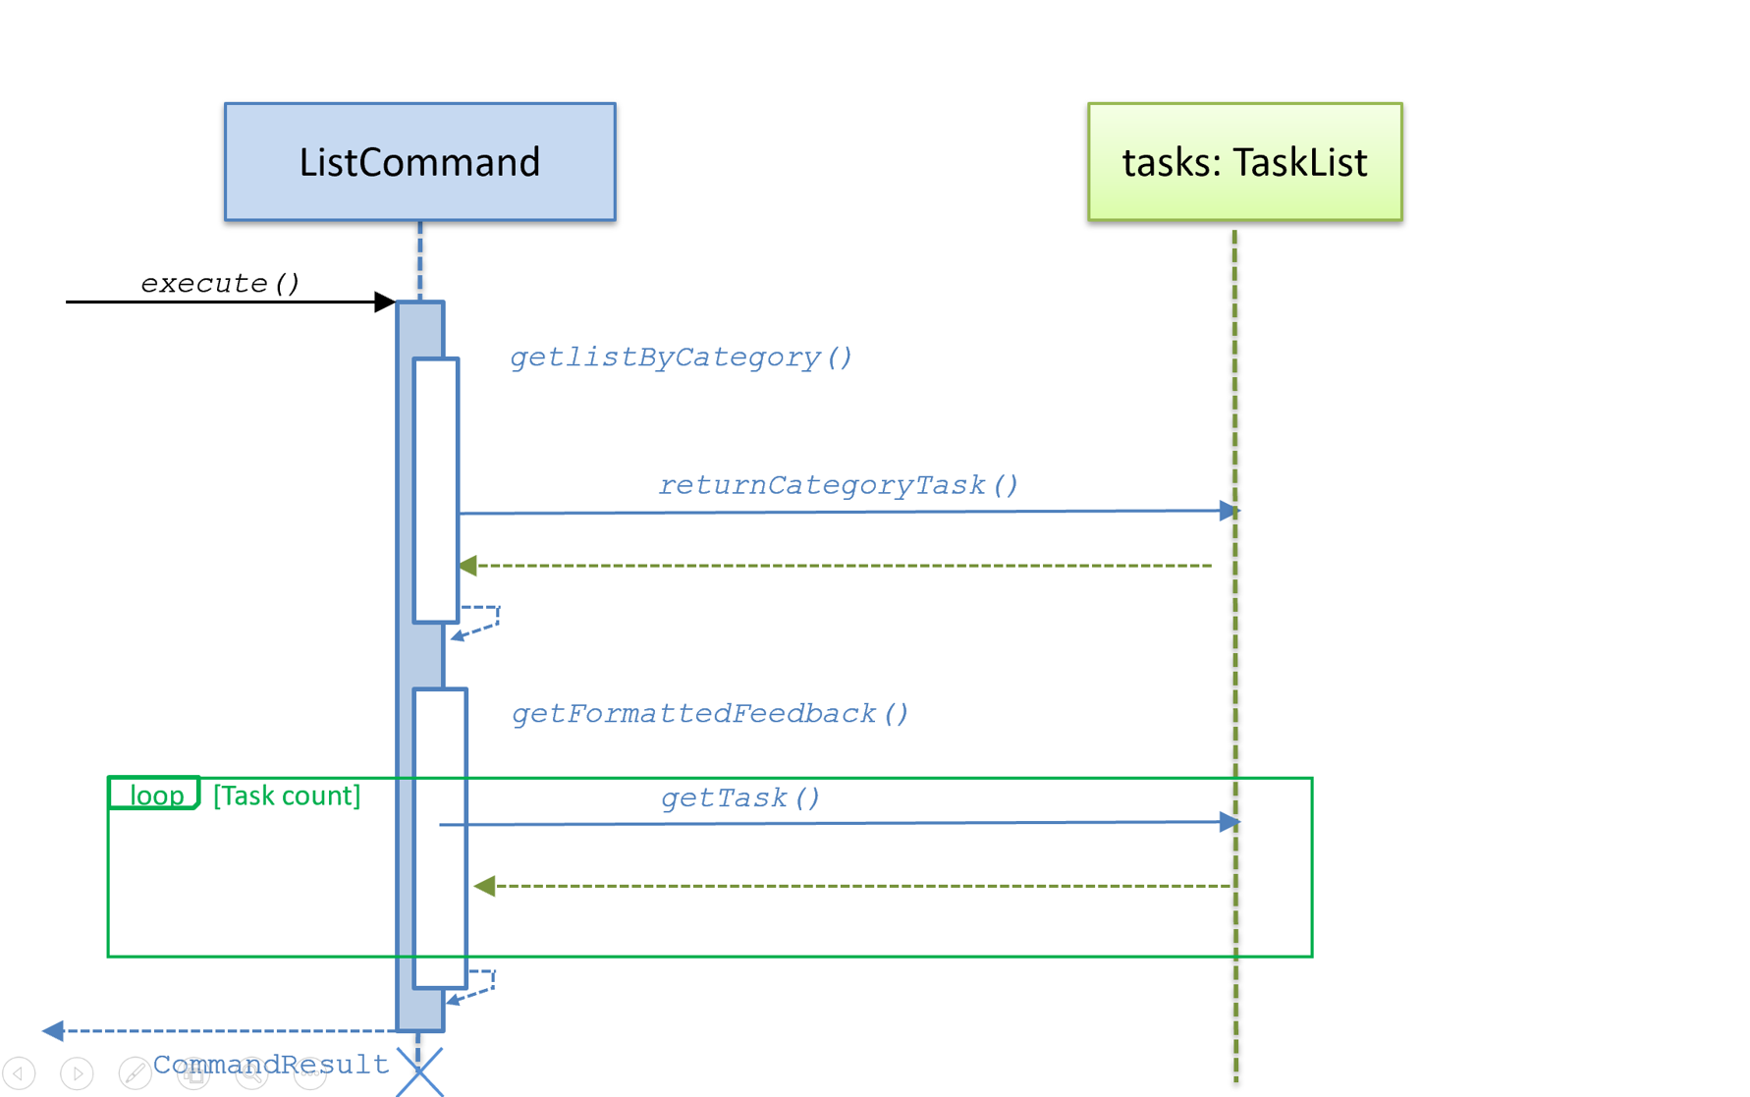

Slide 8
Command{abstract}
uses
UI
+execute(){abstract}
+showCategory(arr[string])
+showTask(arr[int])
DeleteCommand
AddCommmand
+ execute()
- deleteTask (strIndex : String)
- deleteListByCategory (category: String)
- deleteListByDateCategory (String : date, String : time, category: String)
+execute()
1
1
TaskList
-categoryMap: Map(string, arr[int])
-tasks: ArrayList(Task)
1
{Abstract}
Task
*
+returnCategoryTask(category:String):arr[int]
+returnAllCategory():arr[string]
+getListSize():int
+deleteTask(m): Task
+getTask(taskIndex: Integer): Task
~ category: String
+ getCategory():string
+ getTime():ArrayList<LocalTime>
+ getDate():ArrayList<LocalDate>
+ getTask():string
Class
TaskNonClass

Slide 9
Command{abstract}
Storage
{Abstract}Task
~ taskList : TaskList
~ storage : Storage
~ ui : Ui
- gson: Gson
~ title: String
~ description: String
~ reminder: String
~ category: String
~ time: ArrayList<LocalTime>
~ date: ArrayList<LocalDate>
~ location: ArrayList<String>
+ overwriteFile(taskList : ArrayList<Task>)
+ getTitle (userInput : String) : String
+ getDescription (userInput : String) : String
+ getDate (userInput : String) : String
+ getReminder(userInput : String) : String
+ getTime (userInput : String) : String
+ getLocation (userInput : String) : String
+ getCategory (userInput : String) : String
~ checkDateTimeFormate (date: String, time: String)
~ hasWrongDelimiterPattern (input : String) : Boolean
- findField (userInput : String, fromIndex : Integer) : String
+ execute() : CommandResult{abstarct}
*
1
TaskList
-tasks: ArrayList(Task)
+addTask (task : Task)
+Task(title:String, description:String,time:String,location:String,reminder:String,category;String)
~ hasInput(input:String)
+setlocation(location:String)
+setTime(time:String)
+setDate(dateInput:String){abstract}
+ toString() : String
Overwrite Storage
Add tasks
AddCommmand
- userInput : String
+ AddCommand (userInput : string)
+ execute() : CommandResult
- formatFeedback (Task task) : String
CommandResult
- feedback : String
Return CommandResult
Class
TaskNonClass
+ getFeedback() : String
+ CommandResult (feedback : String)
+setDate(dateInput:String)
+toString():String
+setDate(dateInput:String)
+toString():String

Slide 10
AddCommand
tasks: TaskList
: Storage
execute()
Get all field
checkDateTimeFormat(date,time)
alt
[inputCategory != CLASS]
addTask(task)
[inputCategory == CLASS]
addTask(class)
getList()
ArrayList<Task>
overwriteFile(ArrayList<Task>)
CommandResult

Slide 11
Class diagrams
Class name
attributes
methods
association
multiplicity of A
association label
role of B
Class A
Class B
role of A
multiplicity of B
Superclass
<<enumeration>> EnumerationName
inheritance
VALUE_1
VALUE_2
enumerations
Subclass 1
Subclass 2
composition
aggregation
Whole
Part
Container
Item

Slide 12
Class name
abstract/ static
visibility name : type multiplicity = default-value
{abstract} AbstractClass
visibility name (parameter-list) : return-type
classLevelAttribute
interfaces
abstractOperation {abstract}
classLevelOperation
<<interface>> Interface name
navigability
Class 1
Class 2
Class A
Class B
Association class
Class C
dependency
Class A
Class B
Class A
Class B

Slide 13
Class diagrams [example]
< adjacent to
3..8
neighbor
Minesweeper
0..1
Minefield
100
Cell
3..8
played on >
<<enumeration>> AdjacentMines
MinedCell
MineFreeCell
0,1,2,3,4,5,6,7,8
digit: AdjacentMines
1
Mine
Table
- number: Integer
- chairs: Chair [0..6] = null
+ totalTables: Integer
Customer
*
+ getNumber( ): Integer
+ setNumber(n: Integer)
+ getTotal( ): Integer
+ Table(n: Integer, p: Integer)
Reservation
LoyaltyProgram
- startTime
- endTime

Slide 14
Object diagrams
Object Name : Class Name
attributes
[example]
supervises
Jean:Student
Lee:Professor
name = “L. John”
Jon:Student
supervises
:Professor
:Student
:Admin
looked after by >
< looked after by

Slide 15
Sequence diagrams
alt [condition]
<<class>> :Logger
[condition]
name:Class1
[else]
class-level method
loop [condition]
create
:Class2
opt [condition]
self-call
message
return value
par

Slide 16
Sequence diagrams [example]
:TextUI
:MSLogic
<<class>> :Logger
Player
loop [until won|lost]
mark x y
markCellAt(x,y)
log()
getGameState()
Show updated minefield
gameState

Slide 17
Notes and constraints
Note text
{constraint}
Note text
{constraint}
[examples]
This association may change later
{total >= 0}

